Slide 1

Lab 07
FIT5202 Big Data Processing
Classification Models

Slide 2
Session 07 Agenda
•
Session 06 Review
•
Classification Algorithms
•
Decision Trees
•
Random Forest
•
Logistic Regression
•
Model Evaluation
Confusion Matrix
ROC Curve
•
Lab Use Case
•
Bank : Will customers subscribe?

Slide 3
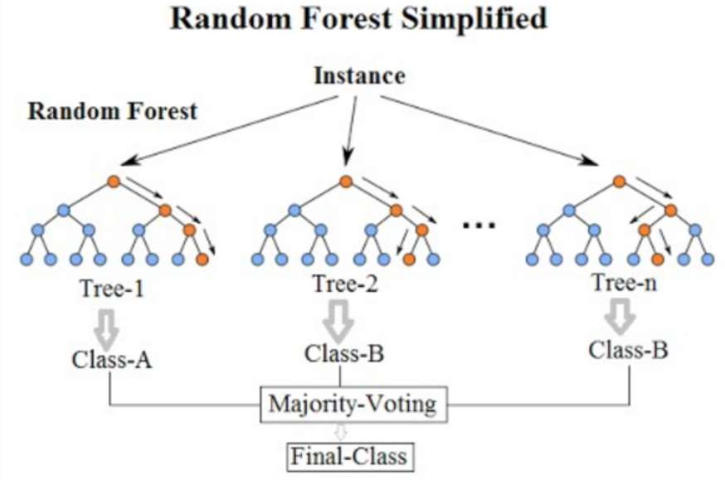
Random Forest
•
Use ensemble approach
•
The outcome of the model
▪
Majority voting (mode) (for classification)
▪
Mean of all outcomes (for regression)
•
Generalise the model
•
Build multiple different (uncorrelated) trees
•
Avoid overfitting issue found in decision tree
•
Use generalisation technique
•
Bagging (bootstrapping) – Randomise (with
replacement) a different dataset (from the training
dataset) used for training each tree.
•
Each tree uses a random subset of features for splitting
nodes.
image: https://medium.com/@williamkoehrsen/random-forest-simple-explanation-377895a60d2d

Slide 4
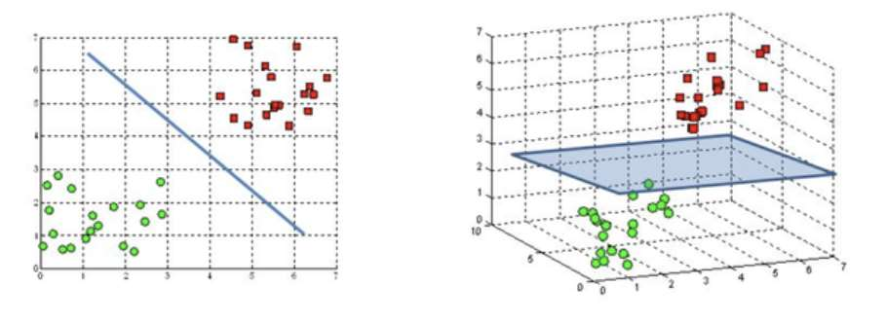
Logistic Regression
•
Based on linear model approach
•
Instead of predicting continuous target variable,
•
Logistic regression predicts categorical target variable (e.g. binary classification)
•
Define the hyperplane (decision boundary) used to classify data (e.g. to
separate the two classes in the data in case of binary classification)
image: https://www.quora.com/What-is-a-hyperplane-in-machine-learning?top_ans=198420733

Slide 5
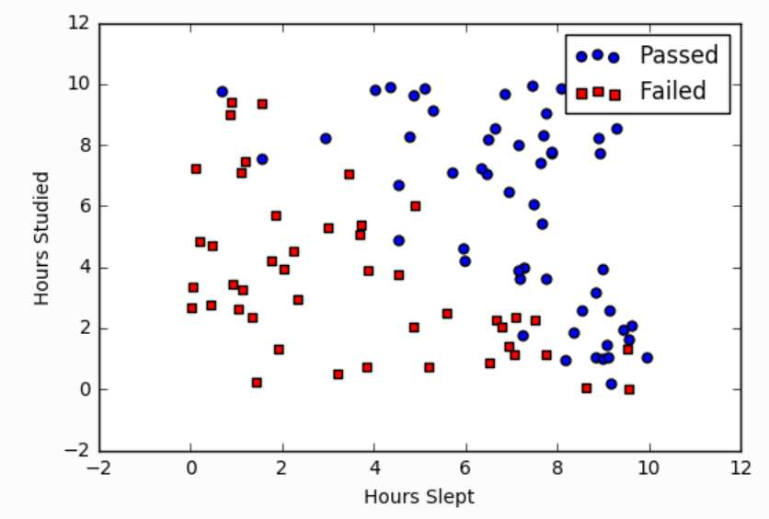


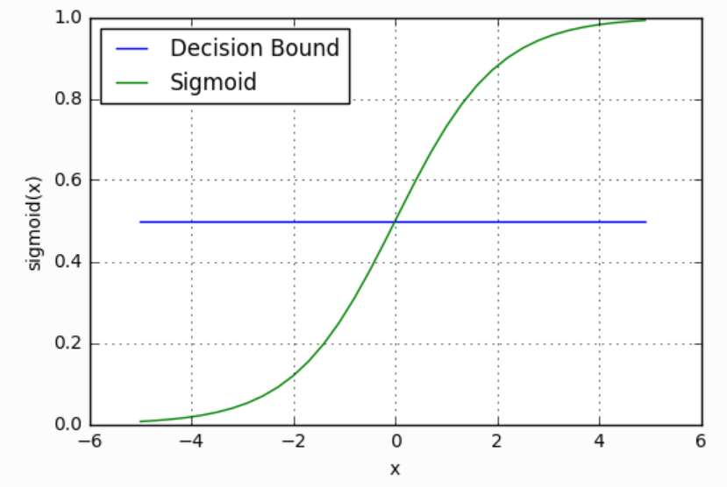
Example: Logistic Regression
•
2 features: Hours slept, Hours studied
•
2 classes: Passed and Failed
https://ml-cheatsheet.readthedocs.io/en/latest/logistic_regression.html

Slide 6
Evaluating Classifiers
•
Threshold Metrics
•
Confusion Matrix
•
True Positive, True Negative, False Positive, False Negative
•
Accuracy, Precision, Recall (sensitivity) and F1-score
•
Ranking Metrics
•
ROC Curve
Classification accuracy is almost universally inappropriate for imbalanced classification.
https://machinelearningmastery.com/tour-of-evaluation-metrics-for-imbalanced-classification/

Slide 7
Choosing the right model?
•
Understand characteristics of your data?
•
Understand characteristics of the model?
•
Meets business goals?
•
How accurate is the model?
•
How explainable is the model?
•
How fast is the model?
•
How scalable is the model?
https://hackernoon.com/choosing-the-right-machine-learning-algorithm-68126944ce1f

Slide 8
Bank Use Case: Will the customers subscribe?
Dataset(csv)
DataFrame
Cleaning
Select
Data Exploration
Features/Columns
Vector Assembler
OneHotEncoding
StringIndexer
ML Model
Prediction

